Slide 1
NSU 2025
TV TENNIS
4
3
STUDENTS:
IVAN KIRYUSHIN DANIIL SMOLIN ELIZAVETA KENIG
2
1
FIT

Slide 2
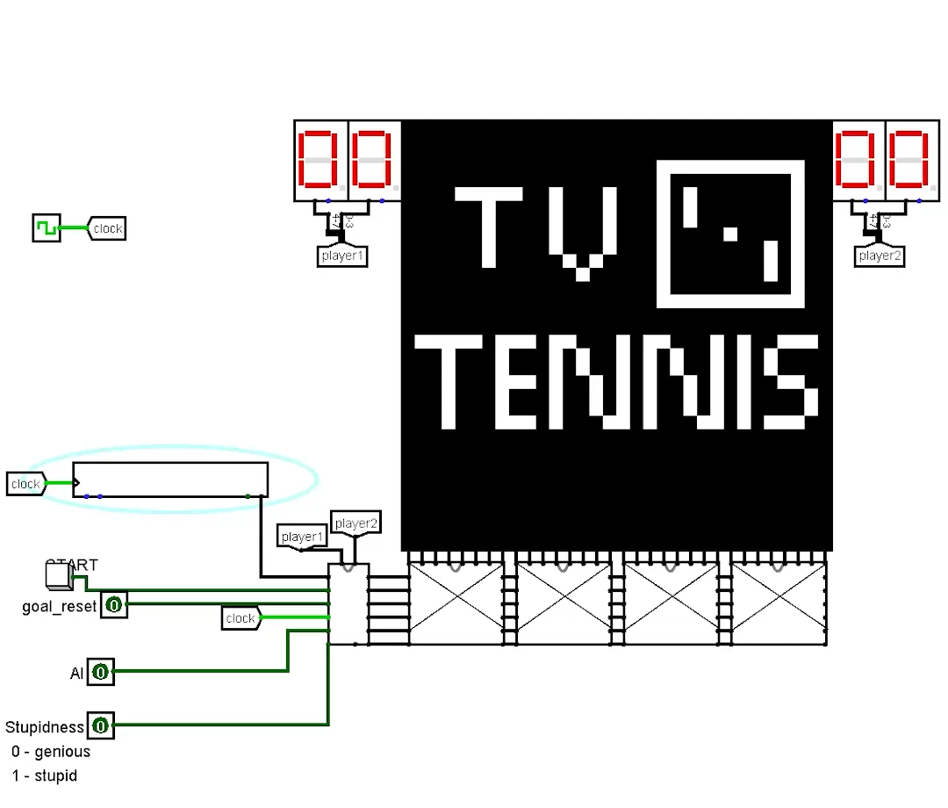
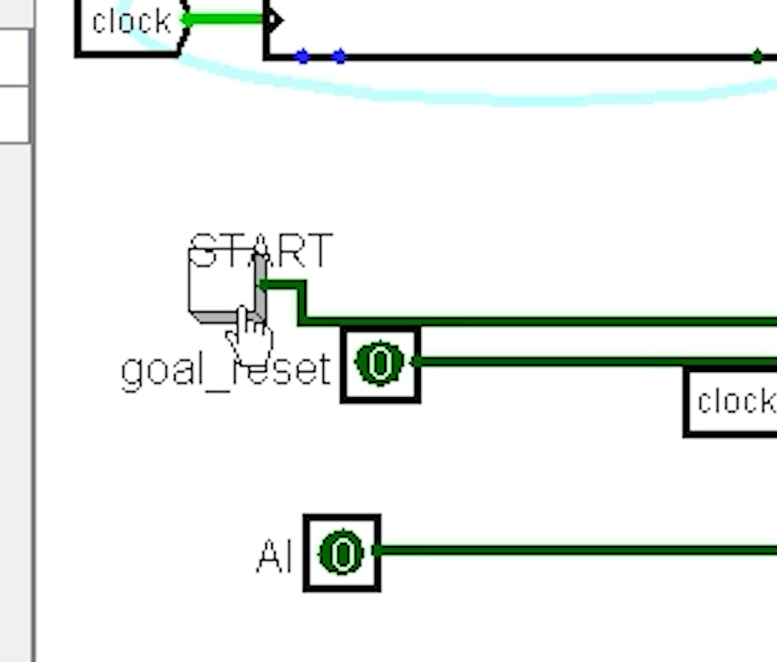
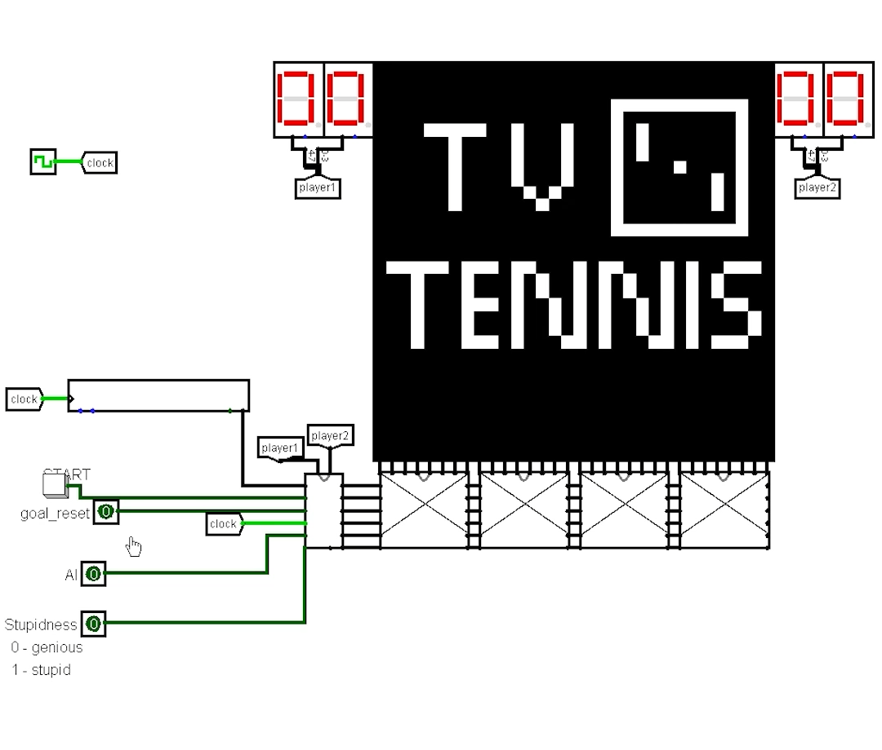
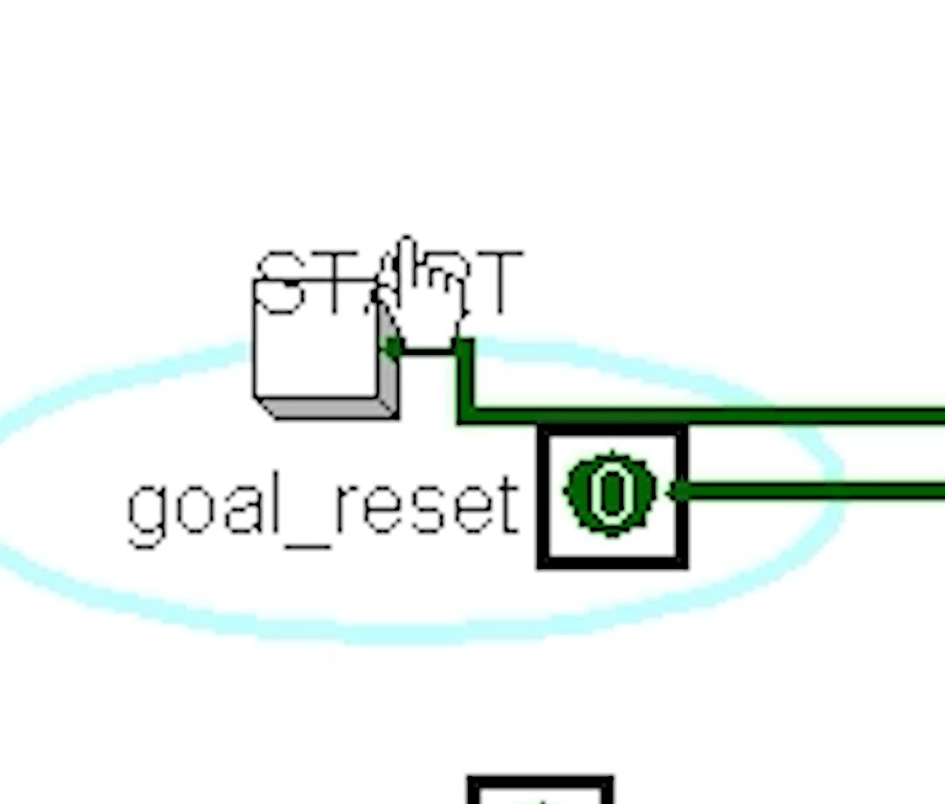
4
GAME SETTINGS
3
USER
INTERFACE
goal reset (0)
non-stop, every time the ball hits the wall behind the bat, only the score is updated
2
1

Slide 3
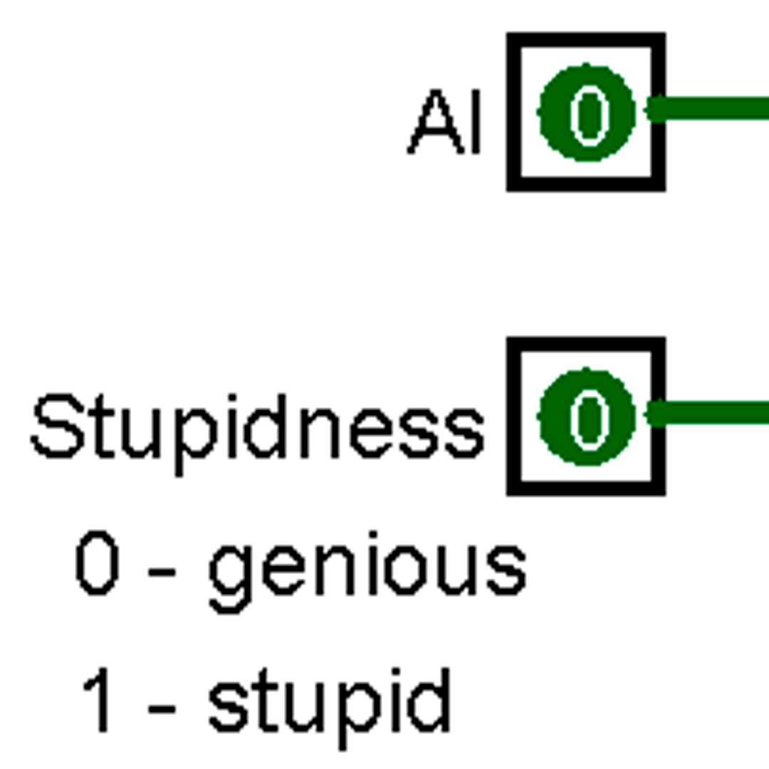
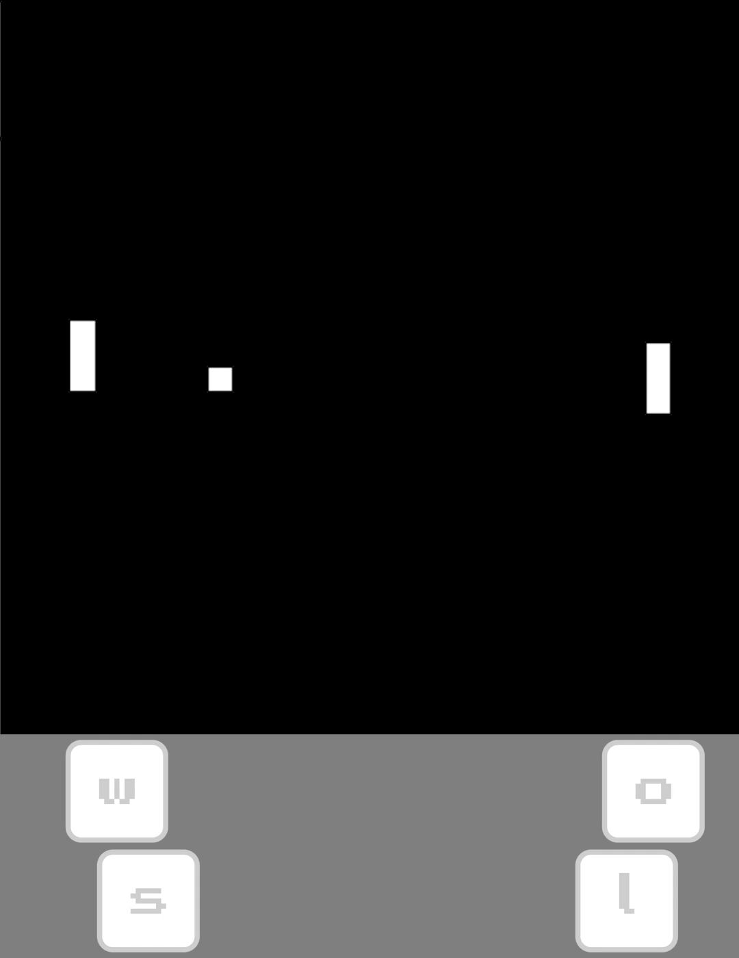
4
GAME SETTINGS
AI MDOES
3
when ai is 0, you playing in mode for two players.
USER
INTERFACE
goal reset (0)
non-stop, every time the ball hits the wall behind the bat, only the score is updated
goal reset (1)
reset after each goal (score updated)
2
1

Slide 4
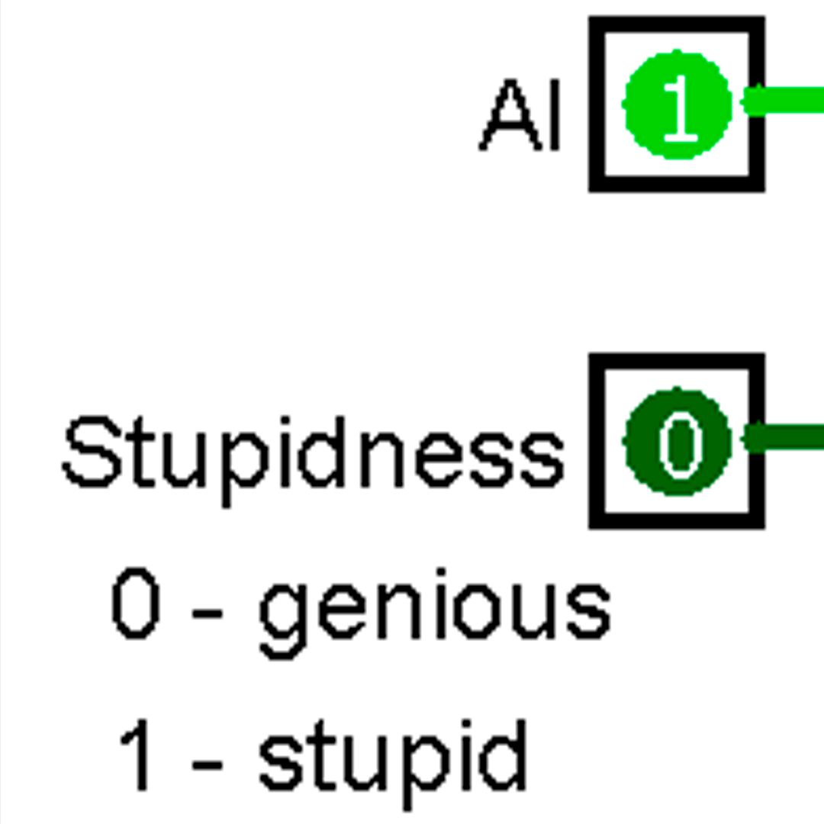
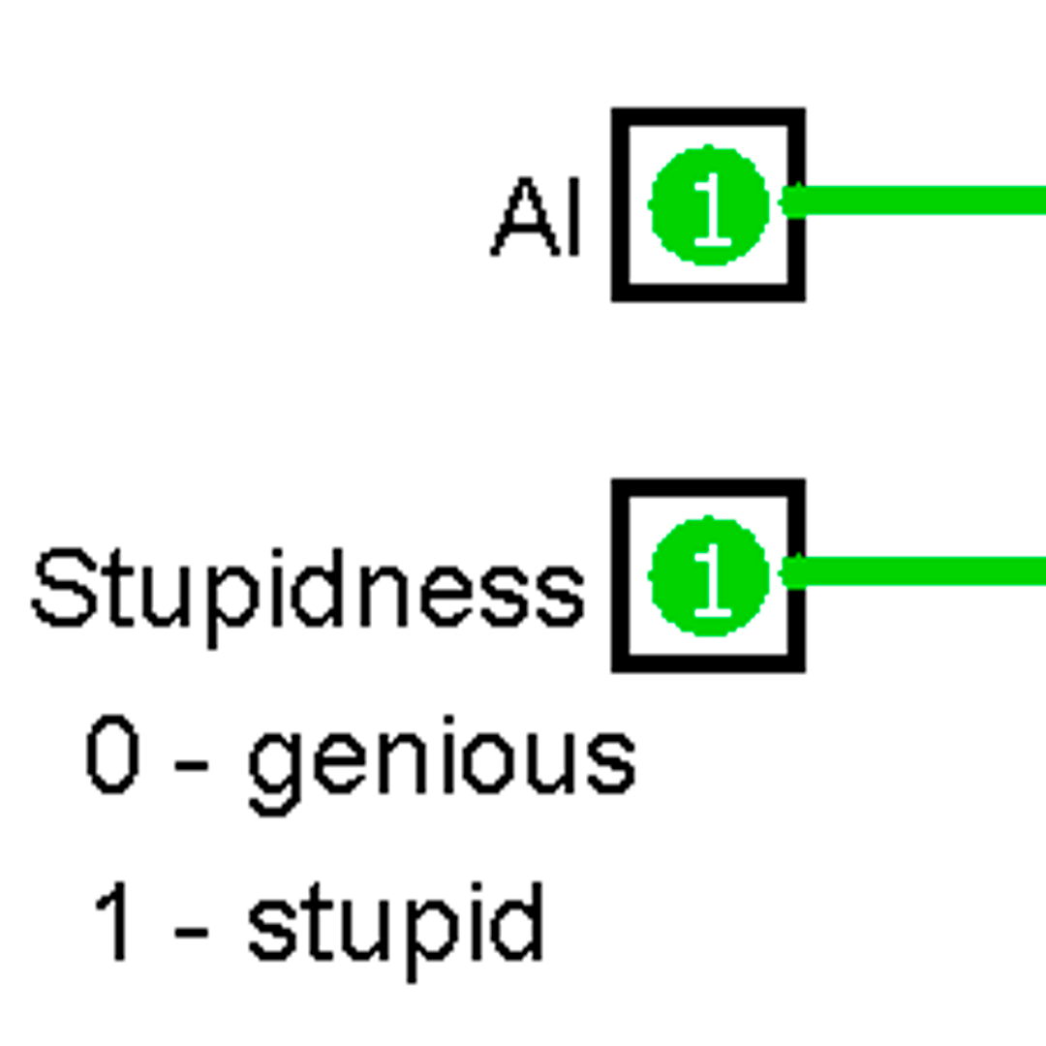
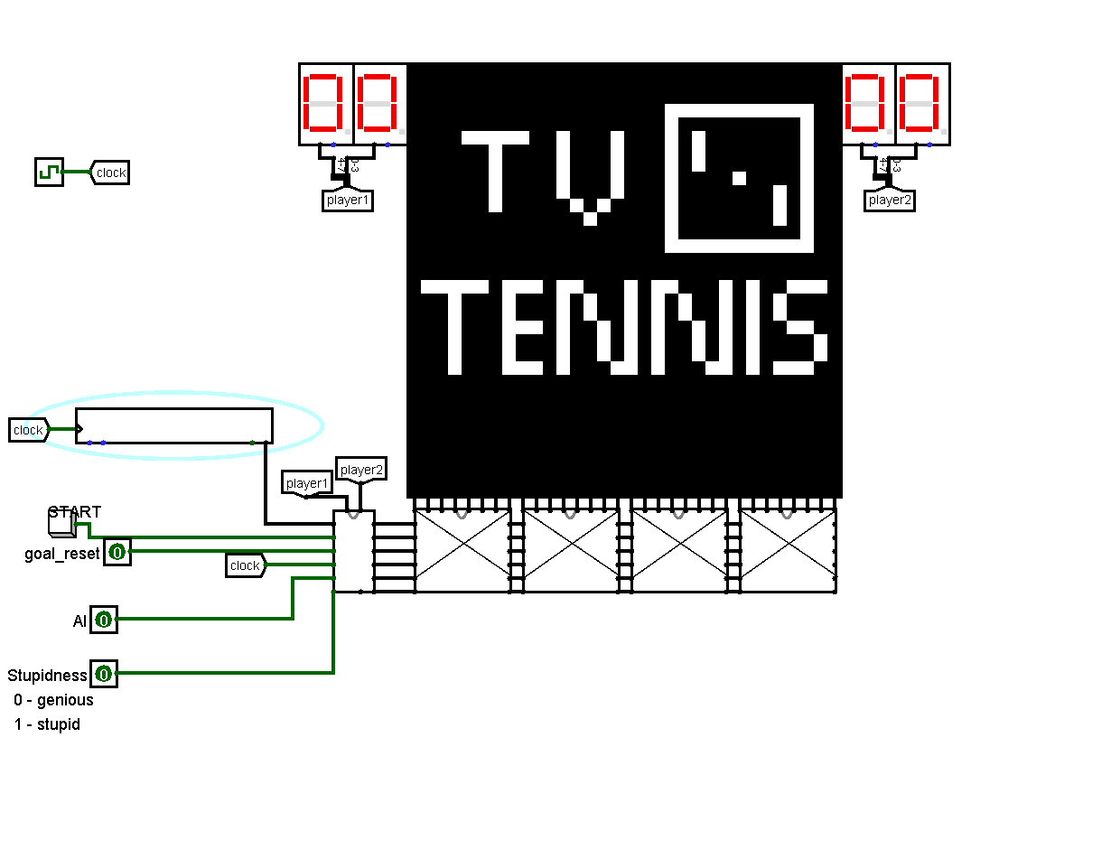
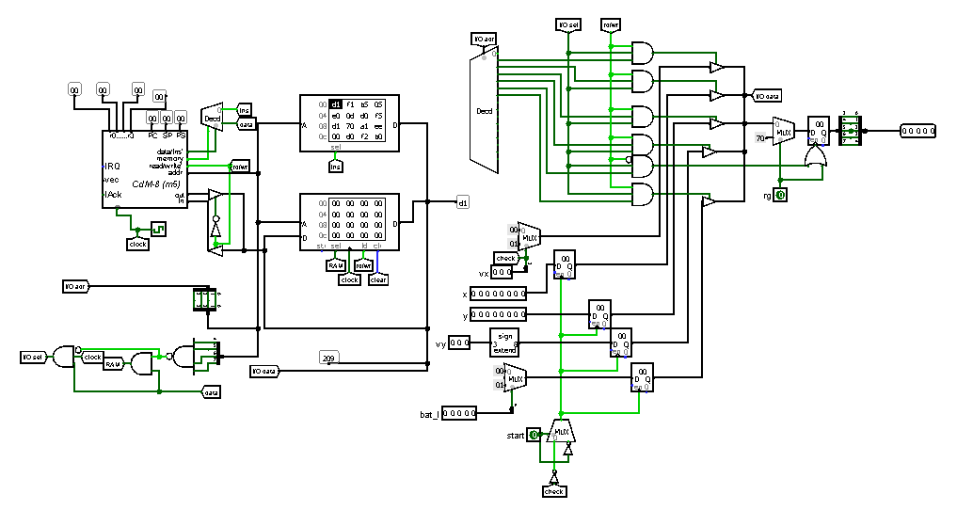


USER INTERFACE
4
GAME SETTINGS
AI MODES
when ai is 0, you playing in mode for two players.
3
when ai is 1, you playing against ai which predict ball next position.
when stupidness is 1, you playing against ai which are making mistakes.
CDM-8
for ai
goal reset (1)
reset after each goal (score updated)
2
1

Slide 5
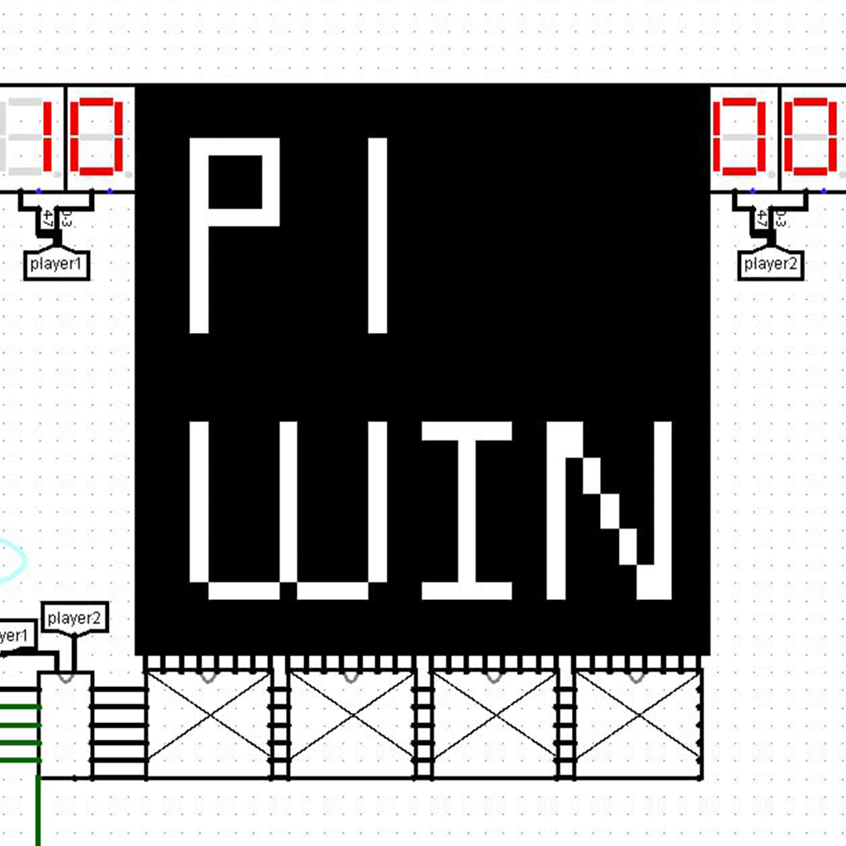
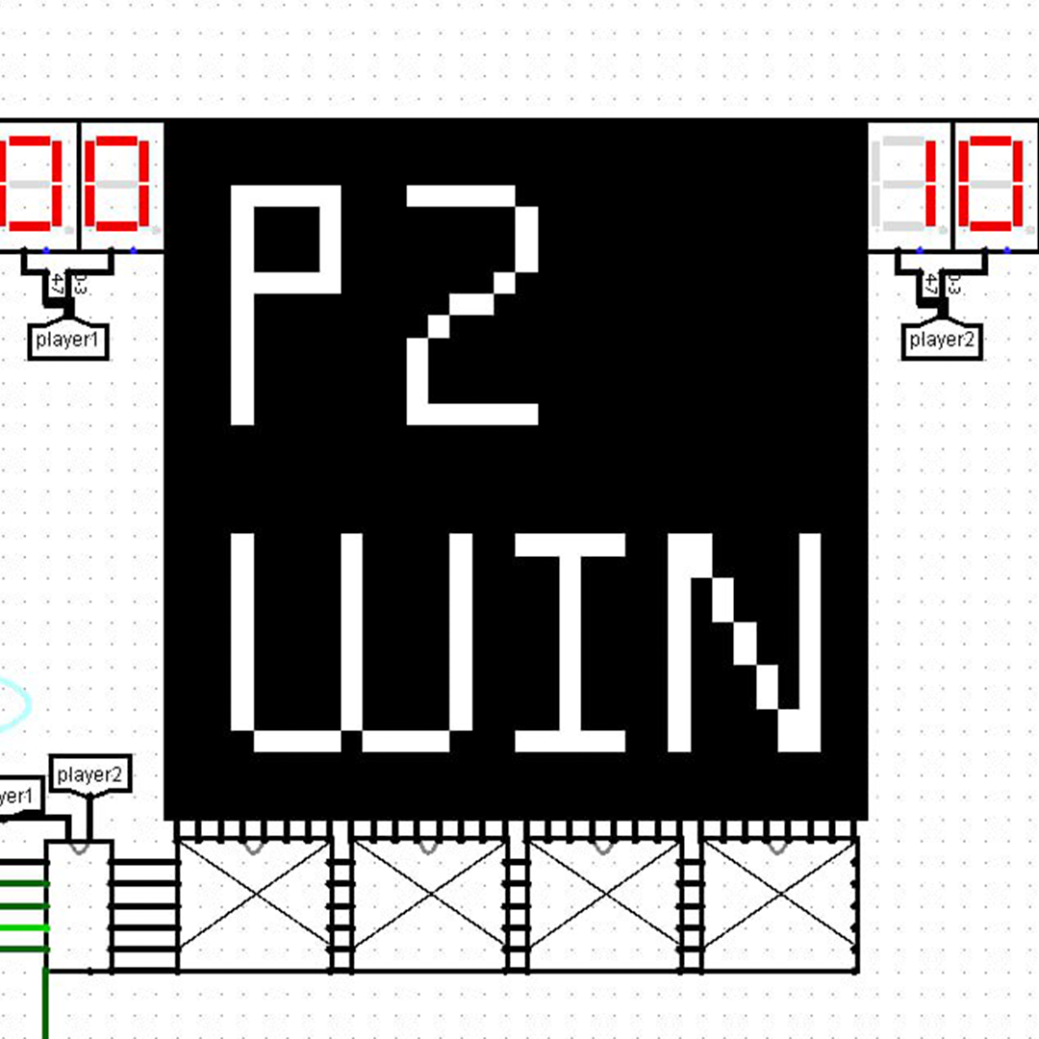
USER INTERFACE
WIN SCREENS
4
3
CDM-8
for ai
2
1

Slide 6
USER INTERFACE
4
WIN SCREENS
3
CDM-8
for ai
2
1

Slide 7
USER INTERFACE
4
3
CDM-8
for ai
THANKS!
2
1

